Slide 1
Blind’s Robotic Stick
For Visually impaired people

Slide 2

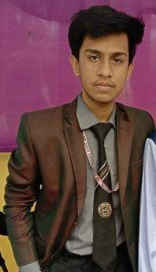

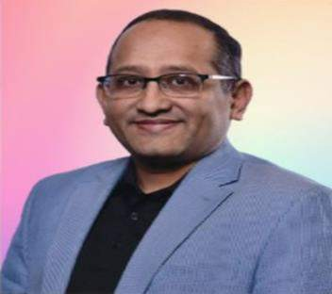
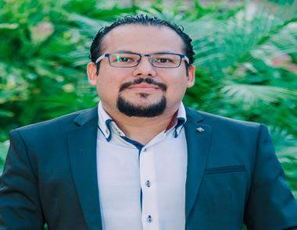
Team Members & Advisors
Engr. Mohammad Farhan Ferdous Founder and Chairman JBRATRC CEO & Managing Director, JBRTL
Fukui, Japan
Khan Prince Yeasir Arafat
Project Developer, Blind’s Robotic Stick
Junior Technical Member, JBRATRC
Shakik Mahmud
Project Director and Project Engineer, JBRATRC
Mohammad Mahdee Uz Zaman Manager, Solution Architect Amazon Web Service, USA
Dr. Manuel Cardona, Professor, Universidad Don Bosco, El Salvador, Central America & International Advisor,

Slide 3

Problems & impacts in real life:
Vision is the most important part of human physiology as 83% of information human being gets from the environment is via sight. According to the World Health Organization (WHO), around 40 million people in the world are blind, while another 250 million people have some form of visual impairment. Coming up to our country, there are almost 6,50,000 blind people.
Quality of Life
Dependence to other people
Difficult of Mobility and easily Falls
Subsequent Injury
No cognition power
High Mortality for accident

Slide 4

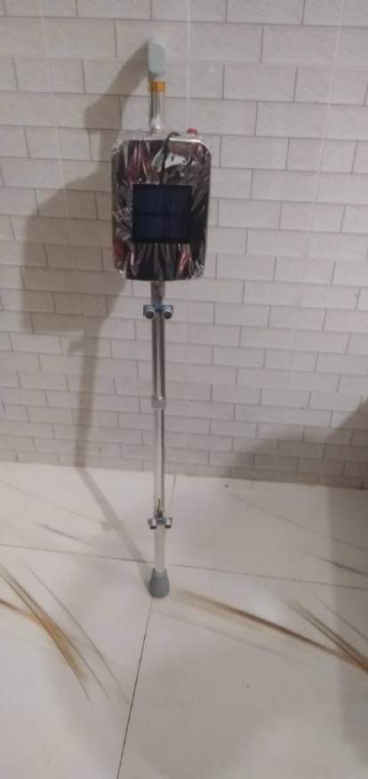
Project Details:
Automatic obstacle sensing system with vibration, alarm output
GPS tracking system with emergency calling feature by pressing a single button
Automatically battery charging system using solar panel
Automatic Object Detection with Voice output system using machine learning
Automatic night indicating feature using LDR sensor

Slide 5

Only main feature’s demonstration in real life under 2 minutes:

Slide 6
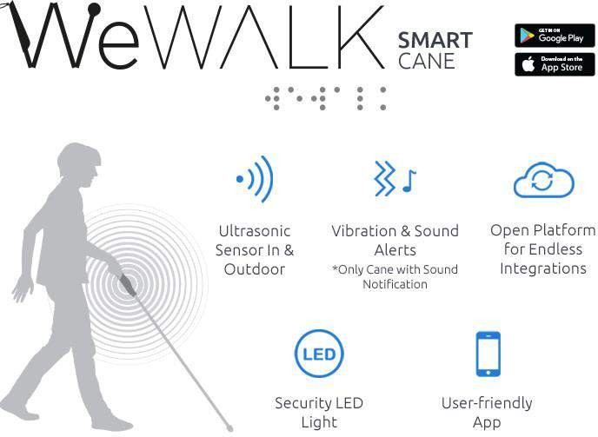
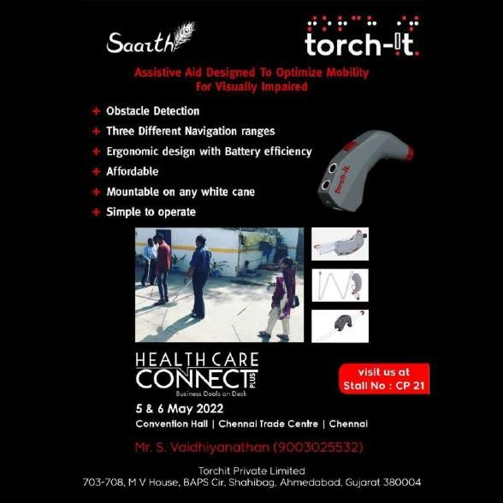
The innovative part of our project & secret creativity:
Our project has lots of features based on the requirements of a blind person. After researching on few blind persons, we successfully made the innovative part of the project which is detecting objects with a voice output system using machine learning. This feature is unique and can’t be found in any other giant companies!

Slide 7
Sustainability & completeness:
Our project is made using the best quality microcontroller and sensors, so this project will sustain approximately 5 years. But our project will be further enhanced by using VLSI technology to design the PCB unit. This makes the system furthermore compact. Also, the use of active RFID tags will transmit the location information automatically to the PCB unit, when the robot is in its range.

Slide 8
**Thank You**

