Slide 1
EARLY DETECTION OF CANCER
CURRENT PERSPECTIVE AND FUTURE PROMISE

Slide 2
Table of contents:
Introduction and solution
Future Promises
Result and Conclusion

Slide 3
Introduction
Cancer is one of the world most debilitating diseases. Early detection of cancer is crucial for its ultimate control and prevention. Around 60% of patients with breast, lung, colon and ovarian cancer have hidden or overt metastatic colonies at present. Most conventional therapeutics are limited in their success once a tumor has spread beyond the tissue of origin.
Biomarkers are important tools for cancer detection and monitoring. Gene mutations, alterations in gene transcription and translation, and protein products can all potentially serve as specific biomarkers for disease. Biological fluids, such as blood, urine, saliva, or other body tissues that are elevated in association with cancer are easy accessible sample sources.
The objectives of the present study is to create a biomarker based device which will detect cancer early.

Slide 4
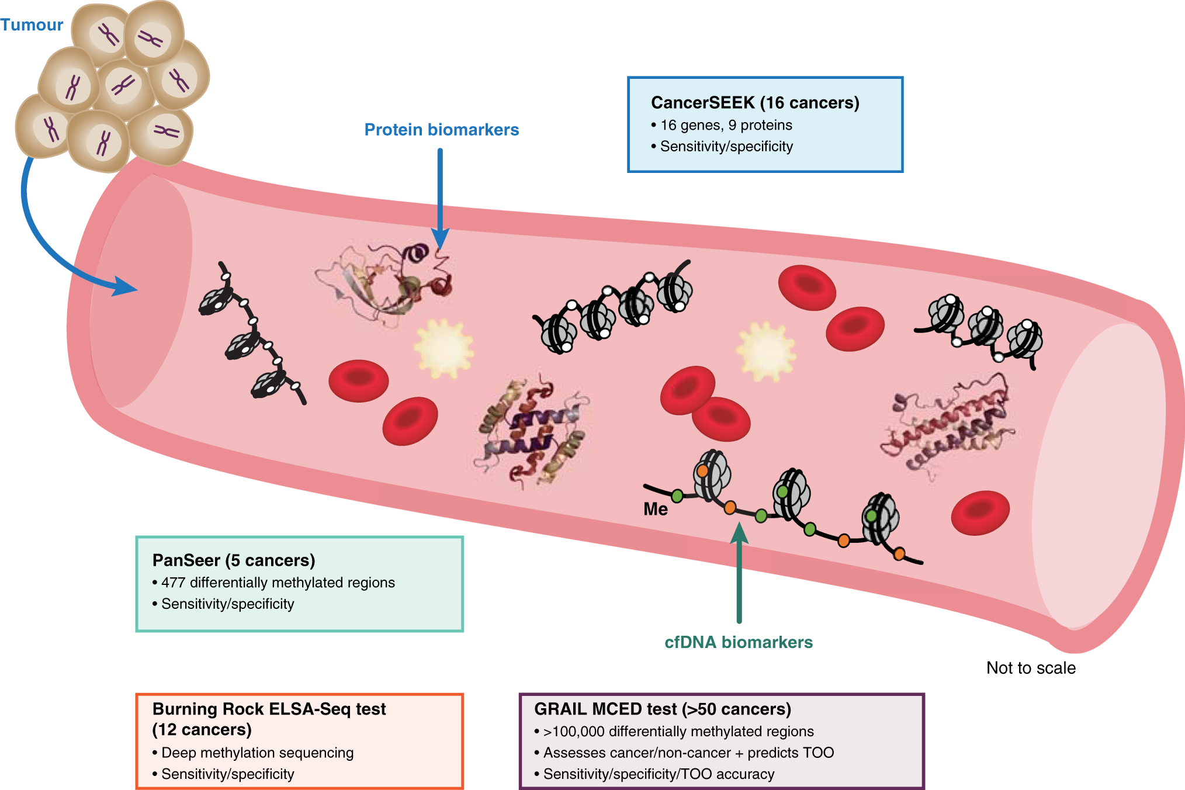
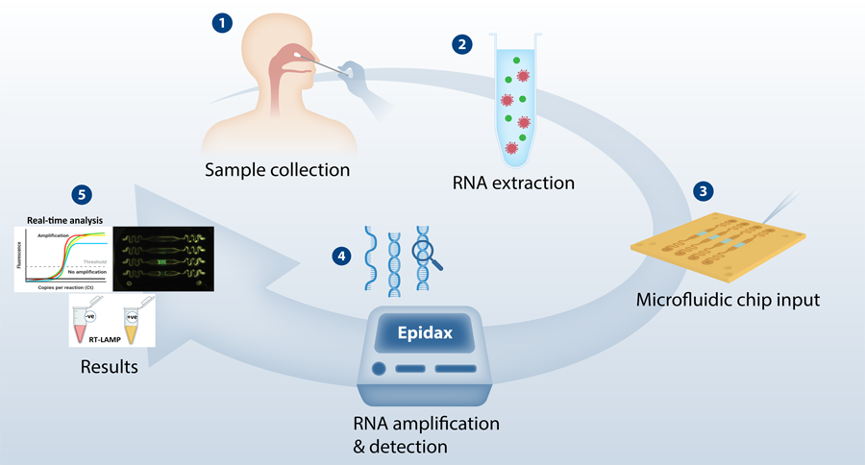
Proposed Solution: I have three recommendations for early detection of cancer which were already experimented. The recommendations may be the effective solution for cancer detection.
Real-time PCR micro device with optical sensors.
1
Noninvasive cancer detection Using Hyperspectral Images
2
Non-invasive early detection of cancer four years before conventional diagnosis using a blood test
3

Slide 5
Future Promises
In cancer, a biomarker refers to a. process that is indicative of the presence of cancer in the body. A biomarker might be either a molecule secreted by. tumor or it can be a specific response of the body to the presence of cancer.
Biomarkers are invaluable tools for cancer detection, diagnosis, patient prognosis and treatment selection. They can also be used to localize the tumor and determine its stage, subtype, and response to therapy. Genetics, genomics, proteomics, many non invasive imaging techniques and other technologies allow measurement of several biomarkers.
Here I will use metal or metal alloys or ionized gas or mixture of ionized gas which will indicate through a change of color or light reflection that there is a cancer germ. In this case different types of cancer will reflect different types of light or change different colors. Through different types of light reflection or different color changes we can understand which types of cancer has germs and at which stage the cancer is present.

Slide 6
Results
The number of biomarkers which are currently used in clinical settings is very small. Few techniques, such as mass spectrometry, provide huge amount of data. Proper validation of most of the cancer biomarkers has not yet been achieved. Here I tried to give an idea of making a machine using biomarker.
Conclusion
A non-contact, non-ionizing and non-invasive cancer detection using an efficient optical imaging tool is being proposed. Five types of cancer can be detected up to four years before conventional diagnosis using a DNA methylation-based blood test.

Slide 7
Thank you
M. Abdullah Khan
United International University
Email: mkhan201036@bseee.uiu.ac.bd
Mobile: 01521715781

