Slide 1
next generation ai cooking robot

Slide 2
The problems in his restaurant
Maintenance
cost
Taste &
Quality
Delivery time
Meet Mr Kusal
Owner of Khanapina, Barisal

Slide 3
PROBLEMS WHAT WE ARE SOLVING
Cost
Time
Lack of Swiftness
Unhygienic
Safety lag
Inconsistent

Slide 4
FEATURES
Personalize
Cooking System
IOT Metrics and AI
New Recipe By Chef
Using our app
Cook Remotely
By our App
Hygienic Maintenance

Slide 5
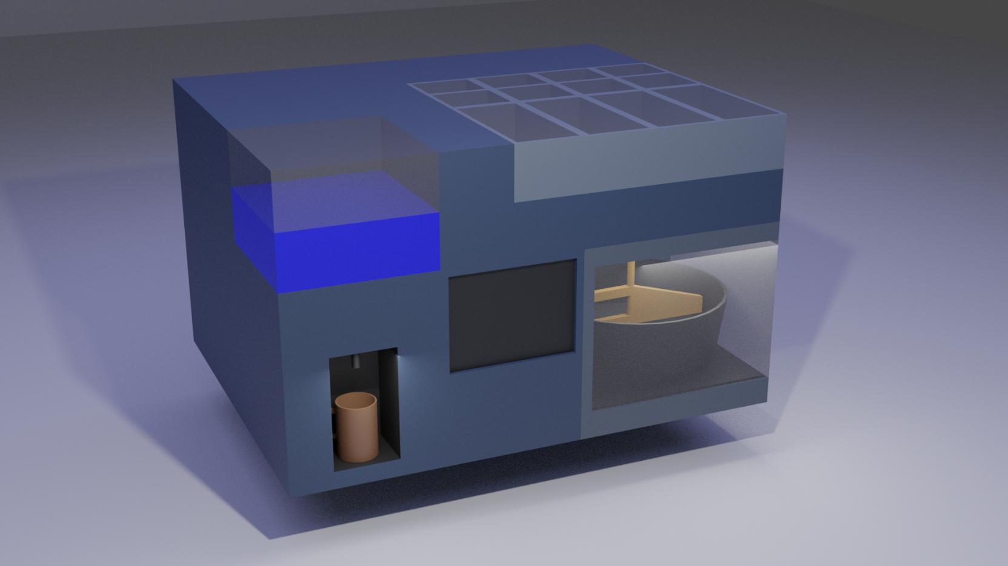
PRODUCT PROTOTYPE

Slide 6
BUSINESS MODEL
Product
Subscription
Model

Slide 7
MARKET
SIZE
60,000+
RESTAURANTS

Slide 8
PRICING AND REVENUE MODEL
TO BUILD A POVARCHEF
WE NEED
APPROXIMATELY BDT
WE WILL SELL IT
APPROXIMATELY BDT
40000/25000
50000/40000
MONTHLY SUBSCRIPTION FEE
199 BDT

Slide 9
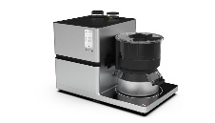
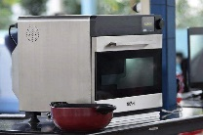
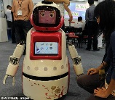
COMPETITORS
WE DO NOT HAVE ANY COMPETITORS IN BANGLADESH
GLOBAL COMPETITORS
RIKU
NOSH
JULIA

Slide 10
Our Vision
Povarchef Horeca (2023)
Povar Partner
(2024)
Povarchef Kitchen
(2026)
Povar Food
(2028)

Slide 11
TEAM
MD AHADUL ISLAM
CEO
+8801765356163
SANIM AHMED
CPO
+8801709797134
MAHIDUR RAHMAN
COO
+8801870490594
TANVIR HASAN
CTO
+8801783896140
NASIF MAHMUD
CFO
+8801876229710

Slide 12
THANK YOU

