Slide 1
Innovation Award
WELCOME To My Innovation Project PRESENTATION
Powered by
Robo Tech Olympiad

Slide 2
Innovation Title :
A Cost-Effective IoT Model
for a Smart Sewerage
Management System
by using
Artificial Intelligence
Innovator
Muhammad Abdur Rouf
CSE, DUET
Dhaka University of Engineering and Technology, Gazipur.





Slide 3
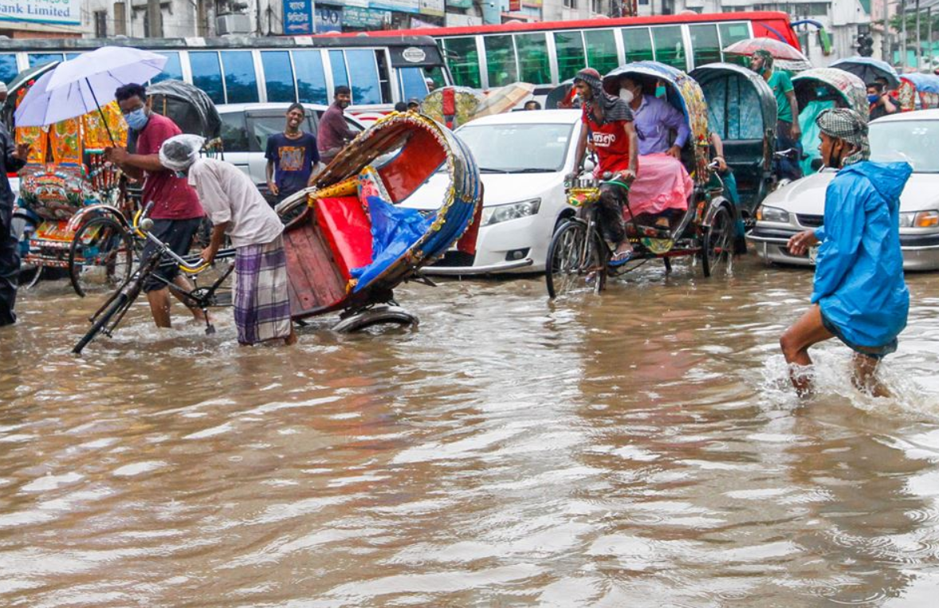
PRESENT SITUATION OF PROBLEM: Water-logging is very painful and frequent phenomena where the authority are trying hard to find out a feasible solution. But sewerage modernization process is extremely complex, expensive and slow process. so It is important to find out optimal solution.

Slide 4
LIMITATION
Very inefficient and
bad effective system
In our existing drains there are many types of problem. Due to the accumulation of dirt, plastic, polythene etc. in the drains, the flow of water in the drains is obstructed. Sometimes the cleaning staff does not understand where the dirt is stuck and where it is possible to clean the drain easily. Doing so, it requires more time and costs. It takes a lot of labor to clean all the drains. Moreover, the drains were usually built a long time ago but now due to the increase in the density of our population, those drains are not able to drain properly. It is seen that water is getting blocked in the drains very frequently. It is not possible for the cleaning staff to clean the drains so often. As a result, the standard of the people living by, has become miserable.

Slide 5
Impact
Social Impact
Environmental Impact
Economic Impact
1.Water Pollution
2. Increase of Water Born Diseases
3. Breeding site of Mosquito
4. Damage of Vegetation and Reduce Aquatic Habitats
Increases of Construction and Maintenance Cost
Shortage of Water
3. Loss of Income Potential
Disruption of Traffic Movement
Disruption of Normal Life
Damage of Infrastructure

Slide 6
02
04
Poor drainage of rainwater leads to the creation of breeding sites for disease vectors.
The storm water becomes polluted as it mixes with solid waste, clinical waste, silt, contaminants, domestic wastes and other human activities that increase the water born diseases.
Breeding sites of Mosquito
Environmental Pollution
Water Pollution
Daily Activities are obstructed
01
The waste management system is another vital issue for a healthy city’s environment.
03
One day of rain causes waterlogging and disrupts life.

Slide 7
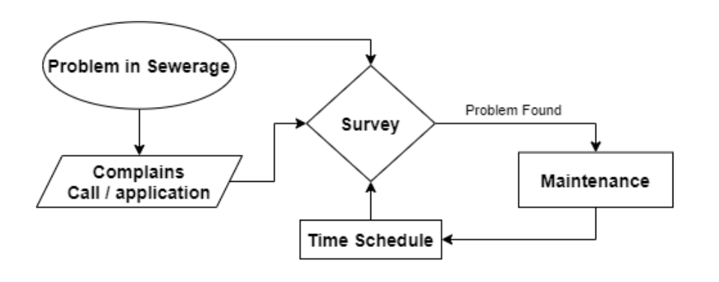
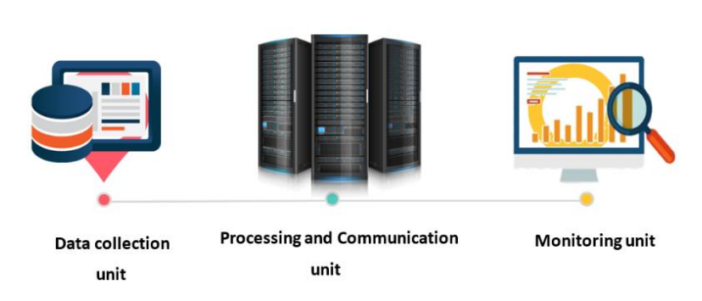
Our Creativity at the IDEA
Fig-b: Architectural Overview of Proposed System
Fig-a: System Diagram of Current System

Slide 8
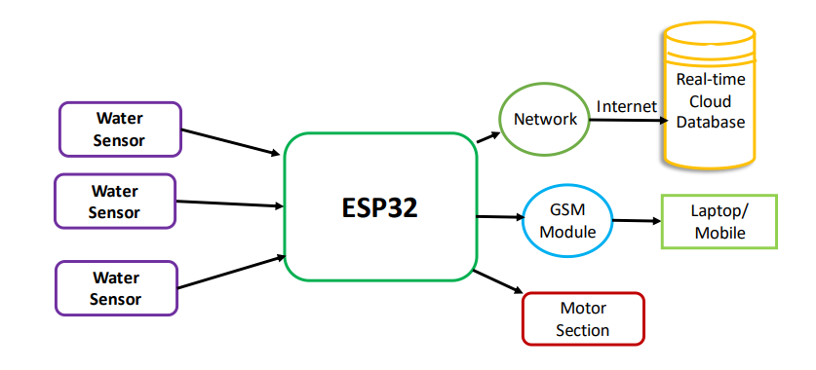
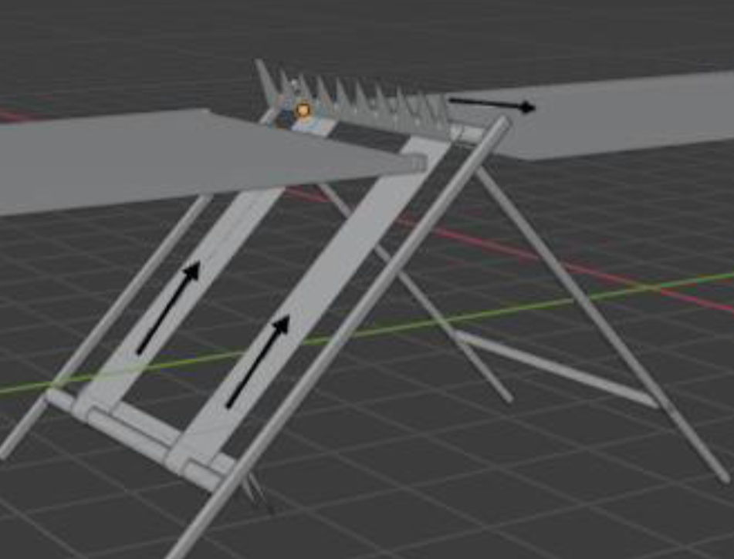
Our Innovation at the IDEA
Fig-b: 3D model of Proposed System’s hardware
Fig-a: System Diagram of Proposed Project

Slide 9
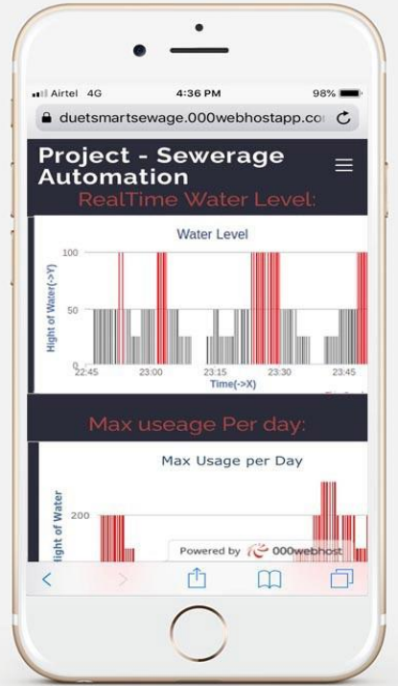
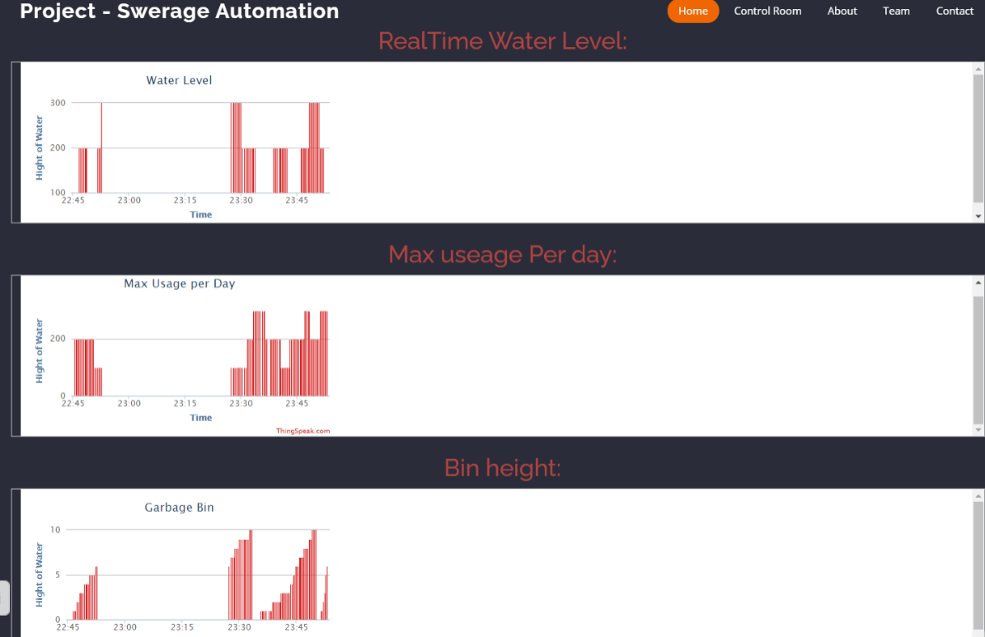
Technical Feasibility to Implement
Figure: Water Level Monitoring by using Web application and Mobile Application

Slide 10
Software
Requirement
Hardware Requirement
Requires programming language knowledge in C++, Python, Java-Scirpt.
Also Arduino IDE, Google fire database , Web development knowledge will be required. Python-Django or WordPress will be used for web app.
Micro Controller: Arduino nano
Wi-Fi Controller: ESP-32
Sensor: Water Sensor.
Two heavy Duty DC motors with respective torque.
Recharge Battery or solar power system.
Ceramic Bearing for longtime underwater usage.

Slide 11
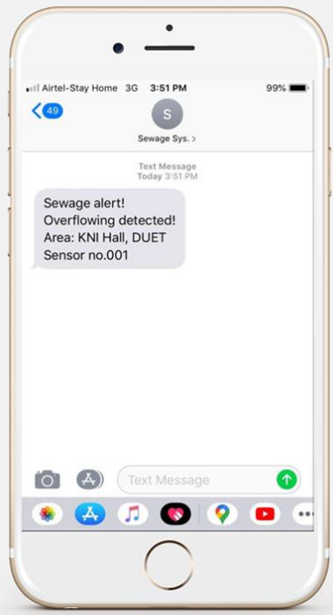
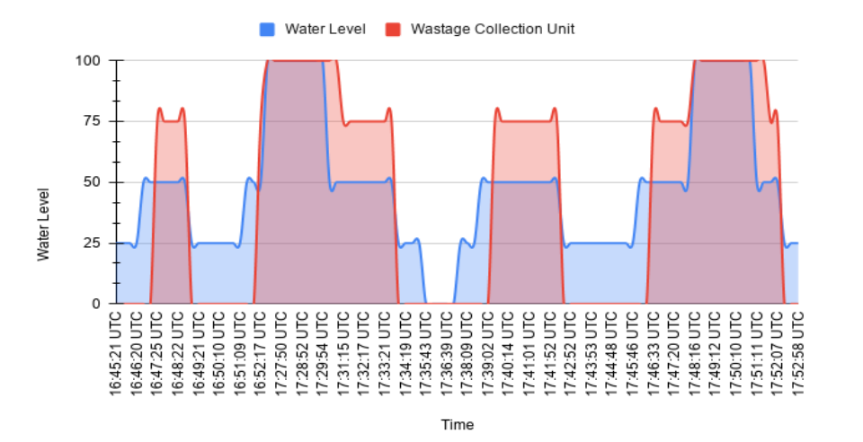
Technical Feasibility to Implement
Figure: Visual presentation of the relationship between water level and the conveyor belt’s motor speed
Figure: . SMS notification when there is an overflow in the system

Slide 12
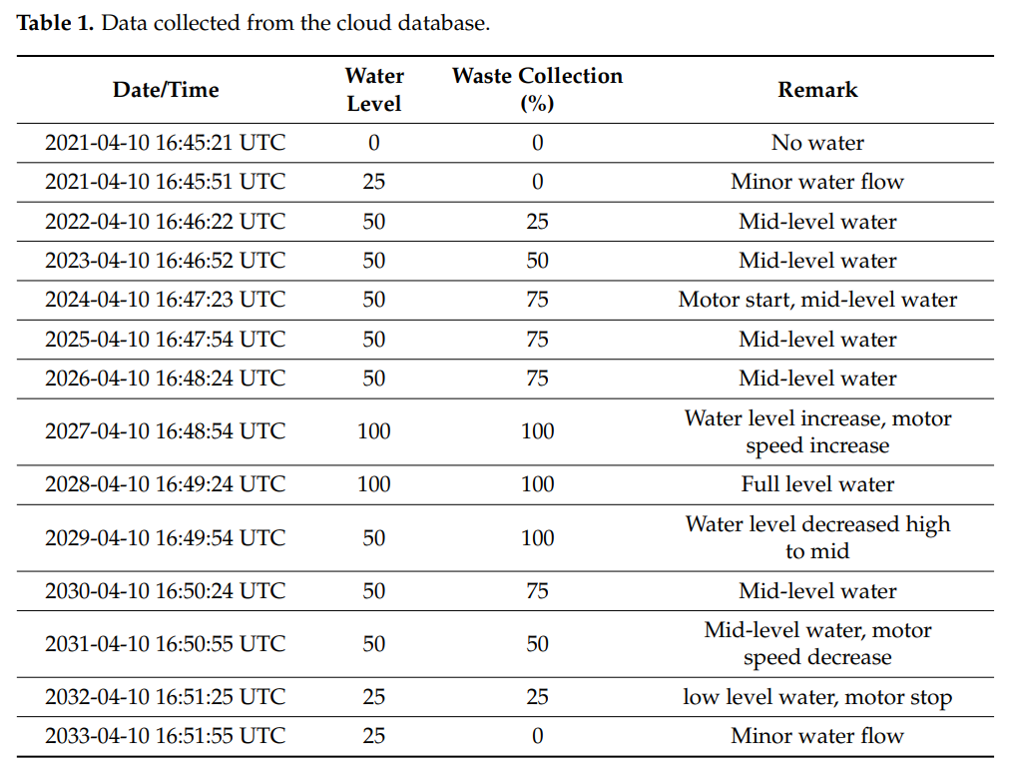
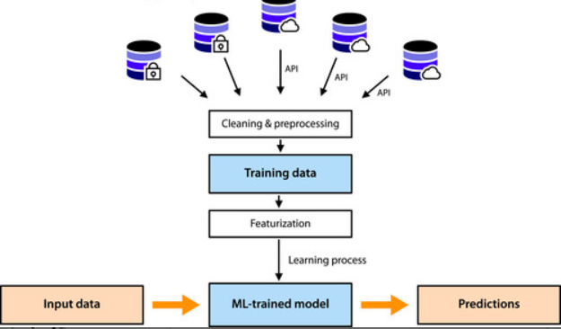
Technical Feasibility to Implement
Figure: Data collection for Data Analysis and Future Prediction by using AI and machine Learning

Slide 13
Solution and Advantages
01
04
05
Future overflow of sewage drain could be avoided
.
Basic unwanted waste removal system to avoid clot
Maintenance requirement alert
03
02
Instant overflow report
An dependable survey report from long time real time data
.

Slide 15
Innovation and Implementation
⬅


By Using sensor
Robotics Bin
Waste-removing mechanisms
Mobile app and Web application
2.Overflow detection.
Notification
Machine Learning
Sending SMS alerts
.
1. Low-cost real-time monitoring
Future Waterlogging Prediction



Slide 16
Powered by
Robo Tech Olympiad

