Slide 1
Automatic IoT based Attendance System Using Artificial Intelligence by Machine Learning Approach.
Presented by:
Md. Selim Hossain
Assistant Network Engineer
Department of Information and Communication Technology
Information and Communication Technology Division, Bangladesh

Slide 2
Table of Contents
1. Objectives
2. Introduction
3. Achievements > Motivation
4. Proposed Methodology
5. Proposed Outcomes
6. Applications

Slide 3
Objectives
Automatic IoT based Attendance System
Artificial Intelligence facial detection system.
To ensure the attendance of the students/staffs/employees
To ensure the awareness among the students/staffs/employees etc.

Slide 4
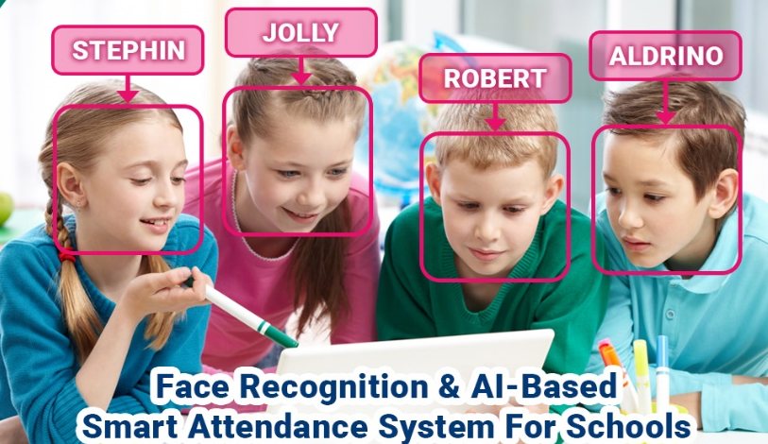
Introduction
The attendance system using artificial intelligence concept mainly works using the concept of facial recognition system was discussed by Akshara Jadhav et al. [1-4]
IoT will play an important role in various applications which are the smart city, smart home, health monitoring, tourism, transportation, communication, business, education, etc. [5-8].
It will helpful to ensure the automatic machine learning based attendance of the students/staffs/employees [9-13].
However, IoT and Machine learning based automation system is urgently needed to make digital Bangladesh more efficient way.
4th Industrial Revolution

Slide 5
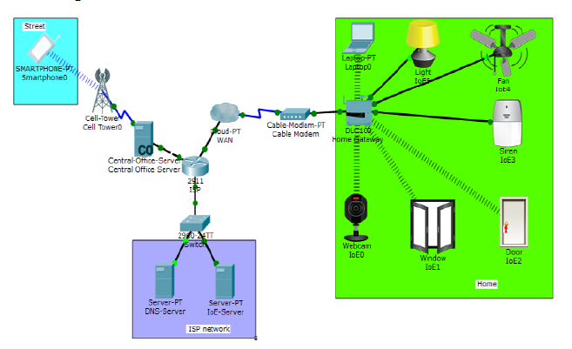
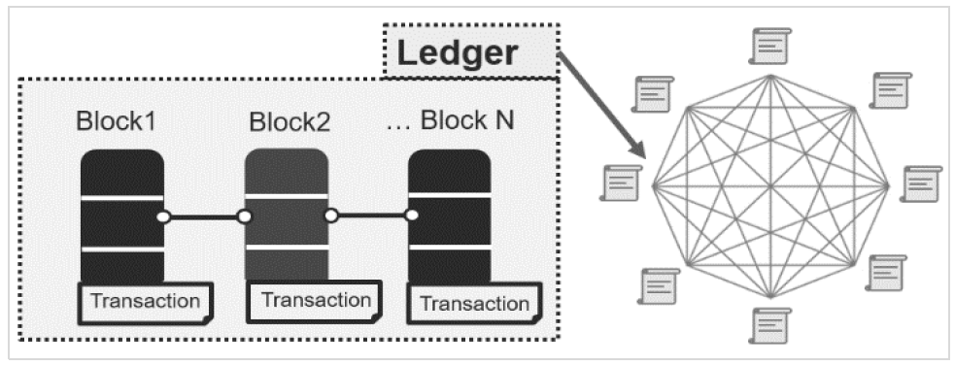
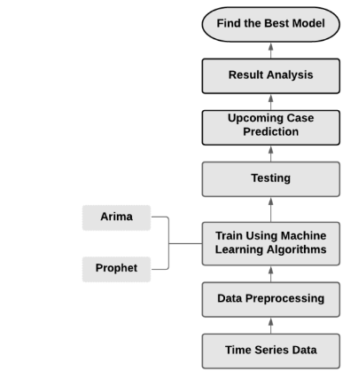
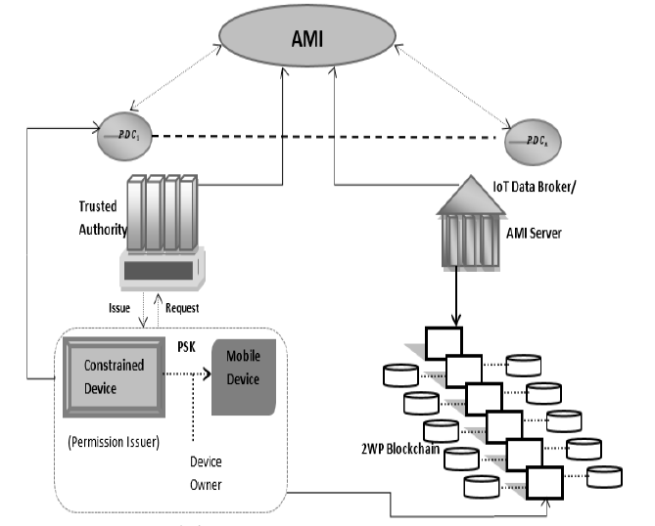
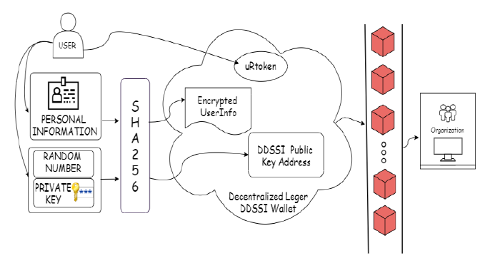
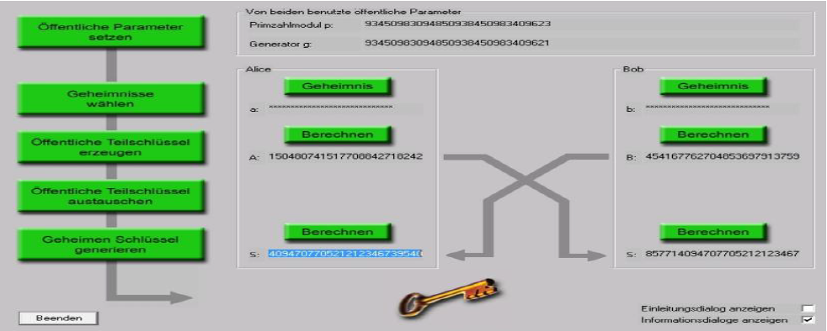
Achievements
Motivation
Md. Selim Hossain, Sajjad Waheed, Ziaur Rahman, SK. A. Shezan, Md. Mahabub Hossain, “Blockchain for the Security of Internet of Things: A Smart Home Use Case using Ethereum”, International Journal of Recent Technology and Engineering (IJRTE), Scopus Indexing, ISSN: 2277-3878, Volume-8 Issue-5, January 2020, DOI: 10.35940/ijrte. E6861.018520
Nishat Ahmed Samrin, Md. Mahmudul Hasan Suzan1, Md. Selim Hossain, Mohammad Sarwar Hossain Mollah, Md. Dulal Haque, Analysis of COVID-19 Trends in Bangladesh: A Machine Learning Analysis, “Lecture Notes on Data Engineering and Communications Technologies” , 978-3-030-90617-7, 519345_1_En, (Chapter 31)
Atiur Rahman, Md. Selim Hossain, Ziaur Rahman and SK. A. Shezan, “Performance enhancement of the internet of things with the integrated blockchain technology using RSK sidechain”, International Journal of Advanced Technology and Engineering Exploration, Vol 6(61),2019.
Zahan A, Hossain MS, Rahman Z, and Shezan S. “Smart home IoT use case with elliptic curve based digital signature: an evaluation on security and performance analysis”, International Journal of Advanced Technology and Engineering Exploration, Vol 7(62), http://dx.doi.org/10.19101/IJATEE.2019.650070.
Md. Tarequl Islam,*, Mostofa Kamal Nasir, Md. Mahedi Hasan, Mohammad Gazi Golam Faruque, Md. Selim Hossain, Mir Mohammad Azad, “Blockchain-Based Decentralized Digital Self-Sovereign Identity Wallet for Secure Transaction”, Advances in Science, Technology and Engineering Systems Journal Vol. 6, No. 2, 977-983 (2021), https://dx.doi.org/10.25046/aj0602112.
Md. Shakilur Islam Sarker, Ziaur Rahman, SK. A. Shezan, Md. Selim Hossain and Md. Mahabub Hossain, “Security Assumptions for Ubiquitous Secure Smart Grid Infrastructure using 2 Way Peg Blockchain and Fuzzy Specifications”, International Journal of Innovative Technology and Exploring Engineering (IJITEE), Scopus Indexing (Q4), ISSN: 22783075, Volume-9 Issue-4, February 2020, DOI:10.35940/ijitee.C8091.019320

Slide 6
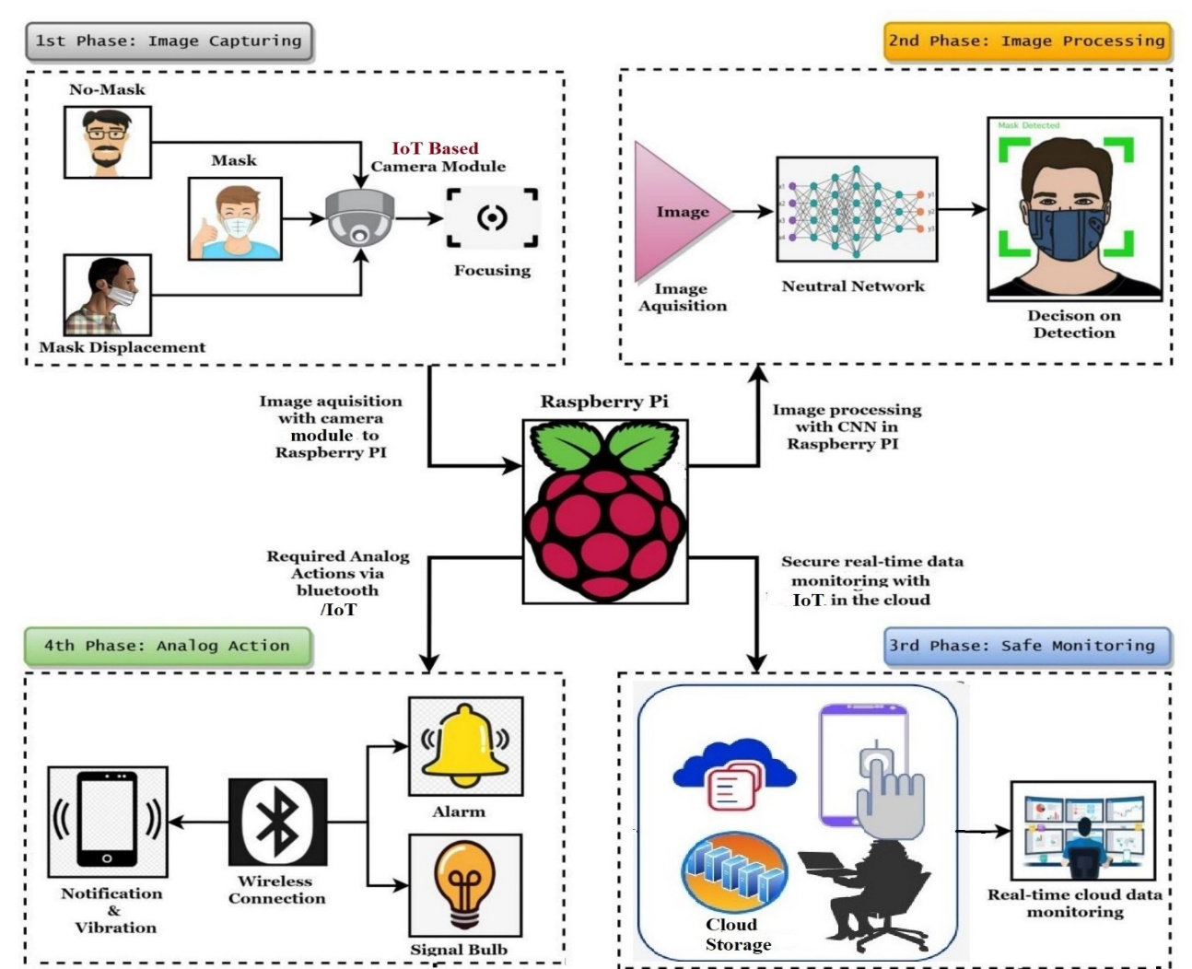
Proposed Methodology..

Slide 7
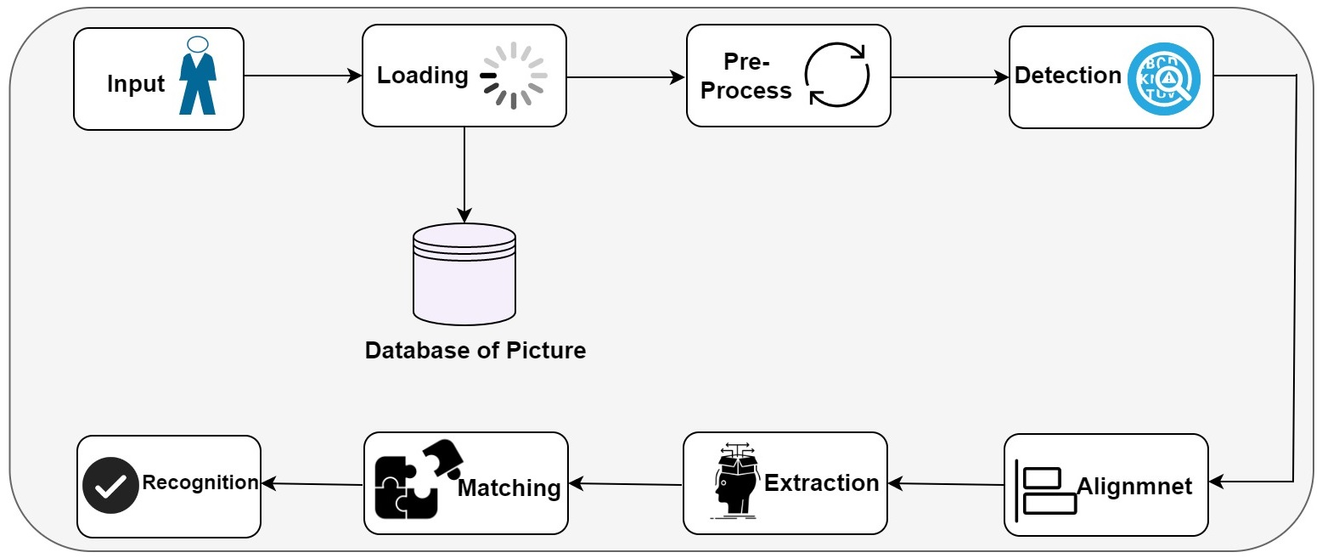
Proposed Methodology
Figure: General Block diagram of IoT based Attendance System Using Artificial Intelligence

Slide 8
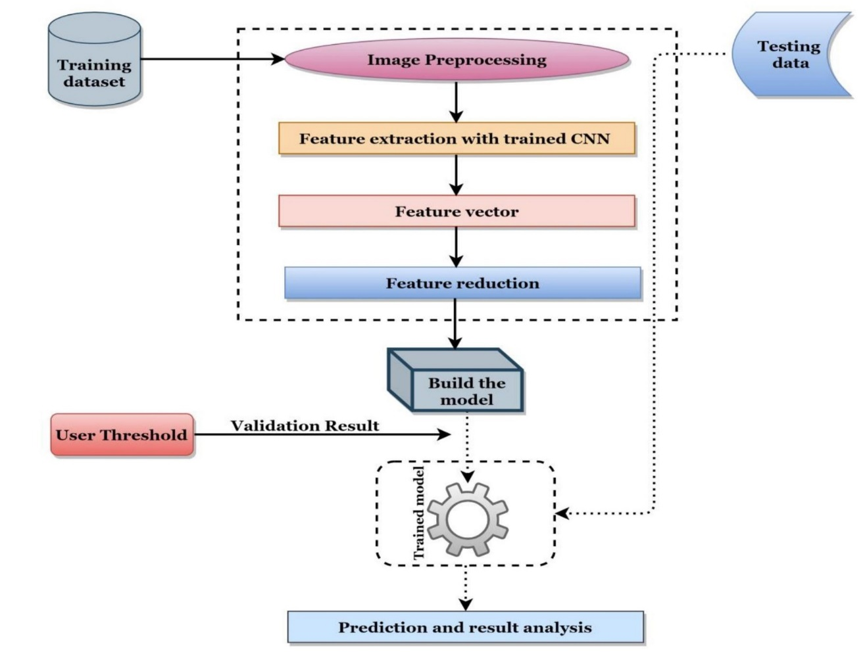
Proposed Methodology……

Slide 9
Proposed Outcomes
Smart AIoT: Automatic IoT based attendance system to decrease the manual errors.
Digitalization: To make digital Bangladesh effectively and efficiently.
Awareness: To ensure the awareness among the students/staffs/employees
Security: To ensure security and privacy of AIoT.
Impact: Direct impact on 4IR
Those proposed outcomes will monitor IoT based attendance system automatically. For the purpose of making Digital Bangladesh, this proposed system will take part of the upcoming era of digital Bangladesh.

Slide 10
Applications
Schools, colleges, universities
The real-time video surveillance will monitor the individuals
Shopping Malls for employee
Hotels and Restaurants
Smart Cities and smart homes
Public and private offices
Hospitals and clinics

Slide 11
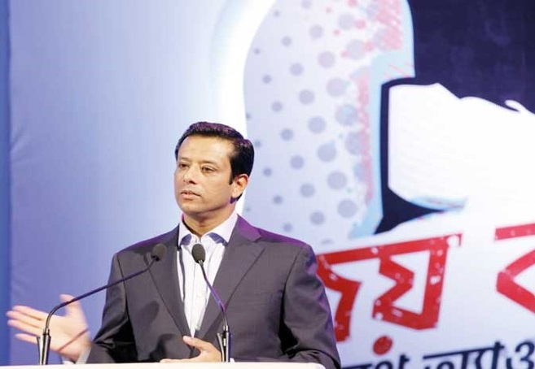
Conclusion
Honorable Prime Minister’s ICT Affairs Adviser Sajeeb Wazed Joy has expressed his optimism that Bangladesh will be the key leader of the 4th Industrial Revolution.

Slide 12
References
[1] Akshara Jadhav, Akshay Jadhav Tushar Ladhe, Krishna Yeolekar “Automated Attendance System Using Face Recognition” Irjet Volume: 04 Issue: 01 | Jan -2017
[2] Lerato Masupha,Tranos Zuva,Seleman Ngwira,Omobayo Esan “Face Recognition Techniques, Their Advantages, Disadvantages And Performance Evaluation” 2015 International Conference On Computing, Communication And Security(Icccs),1-5,2015.
[3] Jireh Robert Jam, Face Detection And Recognition Student Attendance System,Kingston University London
[4] Expert Opinion: The Effect Of Artificial Intelligence On Face Recognition Avaliable At Https://Www.Everteam.Com/En/Artificial-Intelligence-Face-Recognition/ Accessed On (08/10/2019)
[5] Pradeepa .M, H P Mohan Kumar” Face Detection And Recognition For Automatic Attendance System Using Artificial Intelligence Concept”Ijesc Volume 8 Issue No.5 May 2018
[6] Santana Fell “Ai To Mark Attendance” The Telegraph Online Edition Published On Wednesday, 25 September 2019
[7] Chaitanya Reddy “Face Recognition Using Artificial Intelligence” Towardsdatascience.Com In April 2017.
[8] Sulakshana Iyer “Facial Recognition Technology Is Too Great To Ignore” On Soft Web Solutions In March 6th, 2019
[9] Shreyak Sawhney ; Karan Kacker ;Samyak Jain ;Shailendra Narayan Singh ;Rakesh Garg “Real-Time Smart Attendance System Using Face Recognition Techniques” Published In Ieee 2019 9th International Conference On Cloud Computing, Data Science & Engineering (Doi: 10.1109/Confluence.2019.8776934)
[10] Jyothi S Bedre,Shubhangi Sapkal “Comparative Study Of Face Recognition:A Review” In Emerging Trends In Computer Science And Information Technology-2012 And Precedings Published In International Journal Of Computer Applications. [5]
[11] Md. Selim Hossain, Sajjad Waheed, Ziaur Rahman, SK. A. Shezan, Md. Mahabub Hossain, “Blockchain for the Security of Internet of Things: A Smart Home Use Case using Ethereum”, International Journal of Recent Technology and Engineering (IJRTE), Scopus Indexing, ISSN: 2277-3878, Volume-8 Issue-5, January 2020, DOI: 10.35940/ ijrte. E6861.018520
[12] Atiur Rahman, Md. Selim Hossain, Ziaur Rahman and SK. A. Shezan, “Performance enhancement of the internet of things with the integrated blockchain technology using RSK sidechain”, International Journal of Advanced Technology and Engineering Exploration, Vol 6(61),2019.
[13] Zahan A, Hossain MS, Rahman Z, and Shezan S. “Smart home IoT use case with elliptic curve based digital signature: an evaluation on security and performance analysis”, International Journal of Advanced Technology and Engineering Exploration, Vol 7(62), http://dx.doi.org/10.19101/IJATEE.2019.650070

Slide 13
Thank You

