Slide 1
Creative
IT
Zone
Welcome Developers
Shahriar Hussain
Web Developer
Robo Tech Valley Ltd.

Slide 2
What is web Design &
Development ?
?

Slide 3
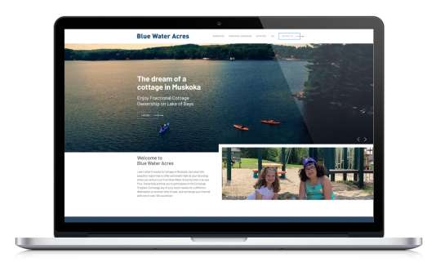
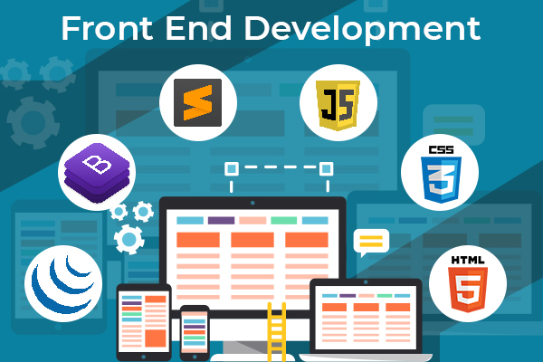
Web Design

Slide 4
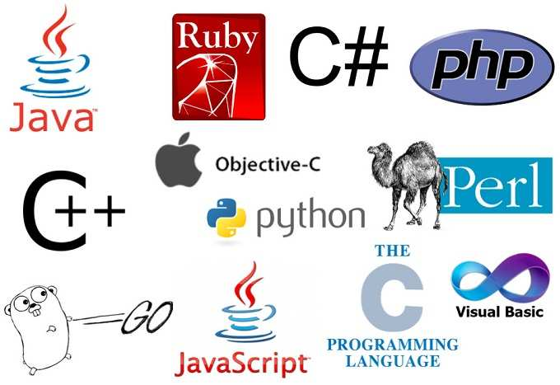
Web Development

Slide 5
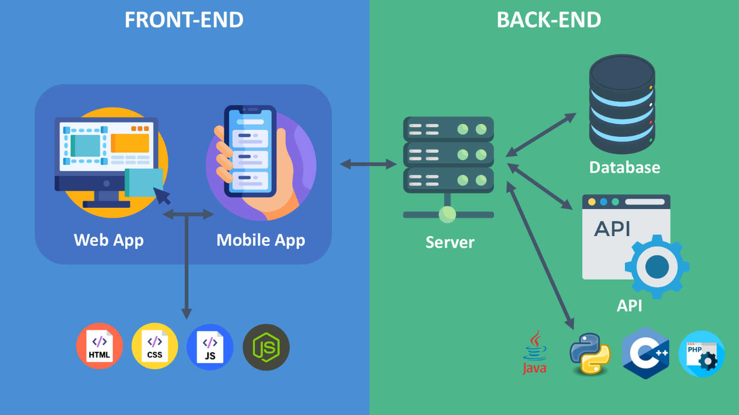
?
Fronend VS Backend?

Slide 6
?
How website works?

Slide 7
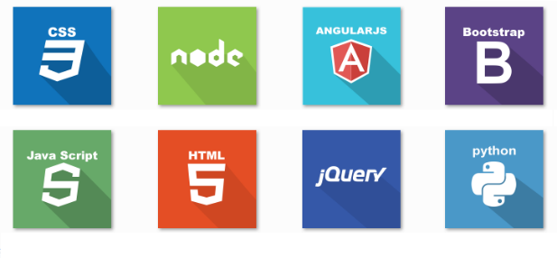
1
How website work?
Backend
Frontend

Slide 10
CONTENTS
1
2
3
4
HTML Intro
Advance CSS
Advance JS
PHP with OOP

Slide 11
1
Roadmap
Development
Before the end we will learn a programming language PHP with its’ OOP.
Our
Roadmap
Learning Javascript
Javascript help us to build a website interactive and charming.
Start with HTML
We will start html and style for css. Then Finish our designing part with JS.

Slide 12
1
Job Opportunities
Instructor, Programmer, Bug Fixer any many more.
Web Designing or Development job: a developer can earn money by doing this for first option.
Remote Developer for foreign company: here is a huge opportunity to be a remote developer
Freelance Developer: you can invest your skills any of a freelancing marketplace and earn.

Slide 13
?
Job Opportunities in Bangladesh for Developer.

Slide 14
2
Job Opportunity in BD
Part time job in BD company
Start your own institution and join any institution as a instructor etc
Working for any institution like Creative zone it.
Fulltime Job in Bangladeshi Company.

Slide 15
2
Market place for developer

Slide 16
2
Web Developer salary in BD
Source: https://www.payscale.com/research/BD/Job=Web_Developer/Salary

Slide 17
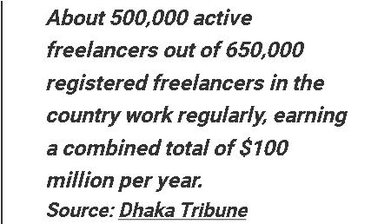
2
Web Developer salary in BD
Source: https://dcastalia.com/blog/the-current-state-of-software-development-in-bangladesh/

Slide 18
Zone
Creative
IT
THANK YOU

