Slide 1
SHAMIMA BINTE ZALIL
PERSONAL PORTFOLIO

Slide 2
SHAMIMA BINTE ZALIL
I T E N T R E P R E N E U R
YEARS OF EXPERIENCE
NOTABLE ACHIEVEMENTS TO SHARE
I have been working for 6 years in
For my leadership and
various domestic and international
communication skills, I have received
leading platforms in the development
crests from various platforms but the
of soft skills like leadership,
biggest achievement for me is to
communication skills of youth.
create a place of trust in people's
Besides, I have provided employment
hearts. As a result of my guidelines,
for more than 30 youth in my startup. I hope, the number will increase day by day.
many youths are now performing
their duties efficiently in the
corporate sector.

Slide 3
EDUCATION
HIGH SCHOOL
Rostom Nager Girl's High School
COLLEGE
Parbatipur Women’s College
HIGHER EDUCATION
Goldsmiths, University of London

Slide 4
LEADER
I have been working as a promising leader in the country's leading youth organization Youth Career Institute for 5 years. I have established a platform called Radsa to educate backward students of North Bengal which is successfully running.I worked as Community Builder of AWS and a Leader of Youth in Digital Awareness and also worked on various national and international platforms.
BOOK WRITER
To change the conventional alphabet learning practice of A for Apple, B for Ball and to introduce the next generation about tech words from childhood, I have written 'Learn Alphabet With Technology' which was unveiled by the Hon'ble Education Minister. Also, I am working on several books on IT skill development including preparatory books for the country's first and largest ICT Olympiad Bangladesh
EVENT ORGANIZER
Organized National Youth Career Carnival to provide career guidance to youth, Organized Campus Leader Summit with 100+ university students for leadership skill development of students, Organized Talk Digital, Make IT Happen and Industry 4.0 etc. events to increase IT awareness, Contributor to e- learning industry in the country Organized hundreds of events including Rising Youth Awards to motivate our youths.
WORK EXPERIENCE
.

Slide 5
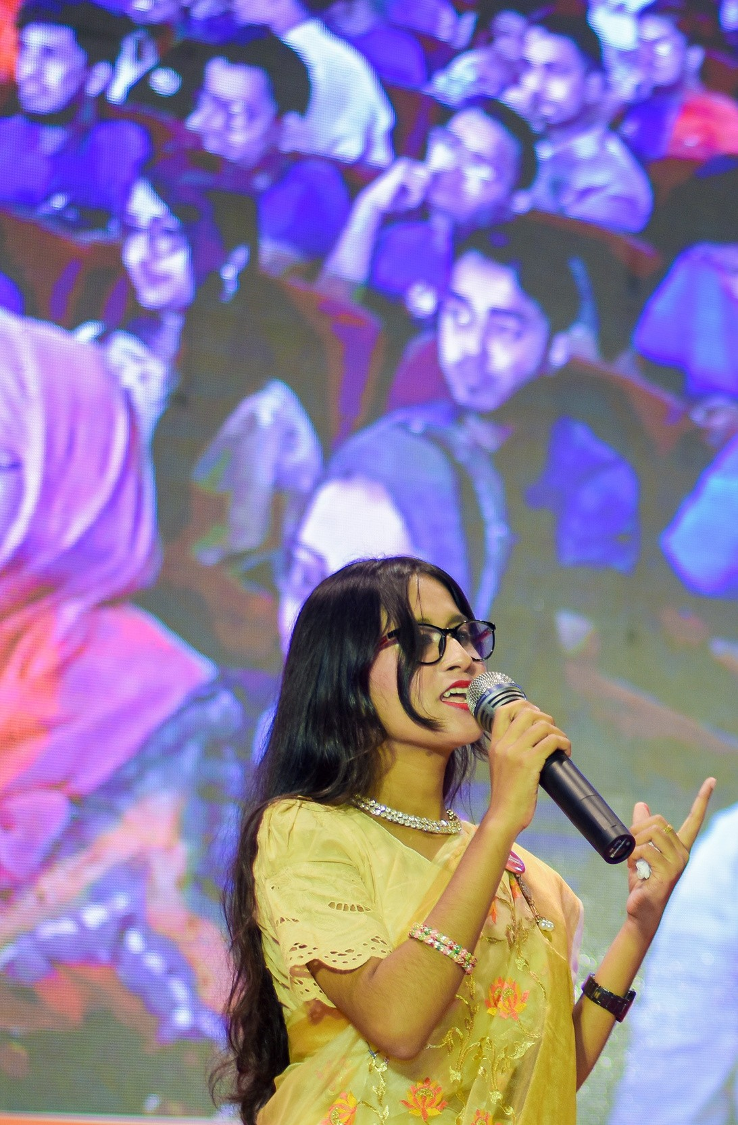
SKILLS & ABILITIES
LEADERSHIP
CONTENT WRITING
PUBLIC SPEAKING
IT SKILLS,PROGRAMI NG
EVENT ORGANISING
COMMUNICATION SKILL

Slide 6
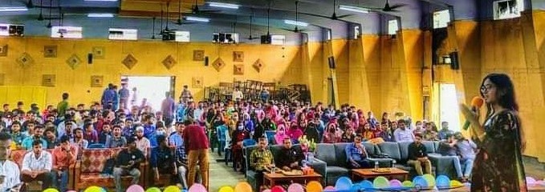
NOTABLE WORKS
EARLIEST TO CURRENT YEAR

Slide 7
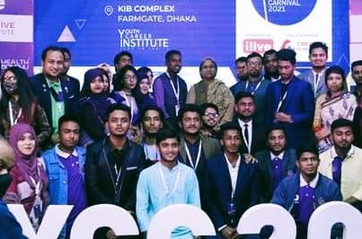
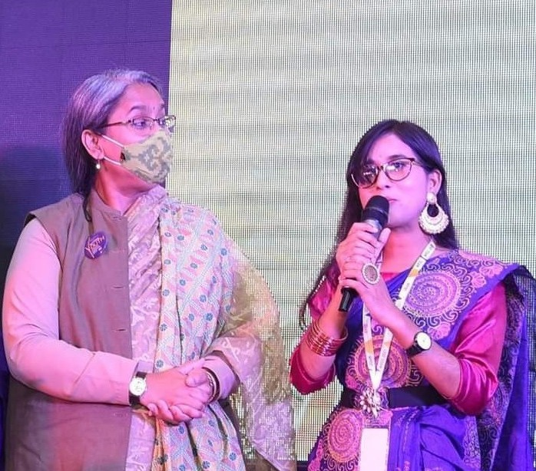
WORK
01
NATIONAL YOUTH CAREER CARNIVAL
With my team I organized the National Youth Career Carnival with around 500 youths and 30+ industry experts. Where career guidelines and outstanding contribution awards are given to the youths. Honorable Education Minister Dr. Dipu Moni was present as the chief guest.

Slide 8
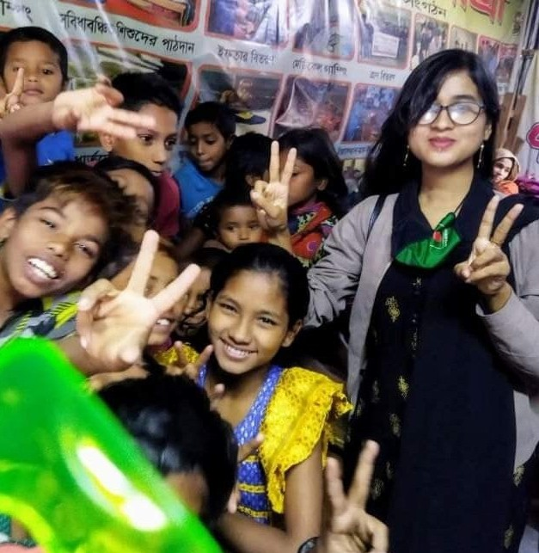
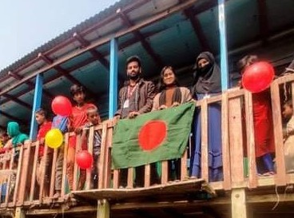
WORK
02
EDUCATION FOR ALL
TO ENSURE EDUCATION FOR ALL, I GAVE EDUCATIONAL MATERIALS AS A GIFT TO VEDED'S FLOATING SCHOOL, UNDERPRIVILEGED CHILDREN'S SCHOOLS BUILT IN DIFFERENT SLUMS FROM MY OWN PLATFORM.

Slide 9
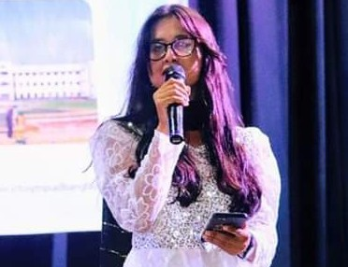
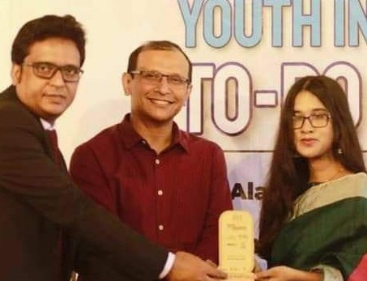
WORK
03
IT KNOWLEDGE FOR ALL
RECEIVED CREST OF HONOR FROM ICT
DIVISION AT
THE END OF THE FOR ORGANIZING
PROGRAM
WORKSHOPS ON IT
SKILL NORTH
DEVELOPMENT AMONG
BENGAL STUDENTS AND
MU SIGNIFICANT CONTRIBUTION IN THIS FIELD.

Slide 10
EMAIL
shamimazalil445@gmail.com
CONTACT INFORMATION
MOBILE
+8801310425267
BLOGSITE
shamimabintezalil.blogspot.com

Slide 11
THANK YOU!

